Slide 1

Weather forecasting
Hemant Sharma, Himanshu kumar, Vishal Takkar, krish Jangra.
Internal supervisor: Dr Jai, External Supervisor: Dr Tanvi
School of Engineering and Technology
Under Supervision of

Slide 2
Weather Forecasting App
Accurate & Real-time Weather Updates
Presented by: [Hemant, Vishal, Himanshu, krish]

Slide 3
Problem Statement
- Unpredictable weather conditions cause inconvenience and risks.
- Lack of real-time and accurate weather information affects travel, agriculture, and daily planning.
- Existing apps may have delayed updates, lack AI-based predictions, or miss localized alerts.
- There is a need for an intuitive, reliable, and AI-powered weather forecasting app.

Slide 4
Solution Overview
- A weather forecasting app providing real-time updates and AI-driven predictions.
- Helps users make informed decisions for travel, agriculture, and daily activities.
- Offers severe weather alerts and personalized notifications.

Slide 5
Key Features - Part 1
- Real-time weather updates
- AI-based weather predictions
- Severe weather alerts
- Interactive radar maps

Slide 6
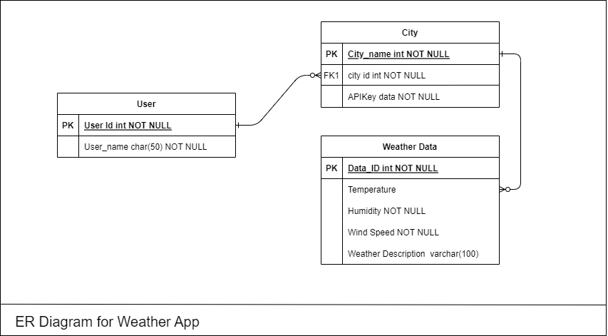
Key Features - Part 2
- Hourly & weekly forecasts
- Custom notifications
- User-friendly interface
- Multi-location tracking

Slide 7
How App works
Frontend Interface
1
Mobile apps built with HTML,CSS, plus web interface using React.js for user interaction
2
Backend Processing
Node.js (Express.js) or Python (Django/FastAPI)
Data management
OpenWeatherMap's API
3

Slide 8
Target Audience
- General users (for daily weather updates)
- Travelers (for trip planning)
- Farmers (for agriculture decisions)
- Businesses (for operations and logistics)

Slide 9
Benefits of the App
- Helps in planning outdoor activities efficiently
- Assists farmers in making informed agricultural decisions
- Provides safety alerts for severe weather conditions
- Improves travel and business planning

Slide 10
Technology Used
- AI & Machine Learning for predictions
- Satellite Data & IoT for real-time updates
- Cloud Computing for fast data processing
- Mobile & Web Integration for accessibility

Slide 11
Conclusion
- A powerful tool for accurate weather forecasting
- Helps users prepare for any weather conditions
- Future improvements: More localized predictions, enhanced AI models, and more features

